Slide 1
Spectral Learning
Advanced NLP 11/29
Hannah Lawrence

Slide 2
Outline
What is “spectral learning”?
Review of linear algebra + statistics
Example: Learning HMMs
Example: Spectral clustering
Paper 1: Word embedding
Paper 2: Word embedding fusion
Paper 3: Supervised topic modeling
Paper 4: Parsing with L-PCFGs
Discussion questions

Slide 3
What is spectral learning?

Slide 4
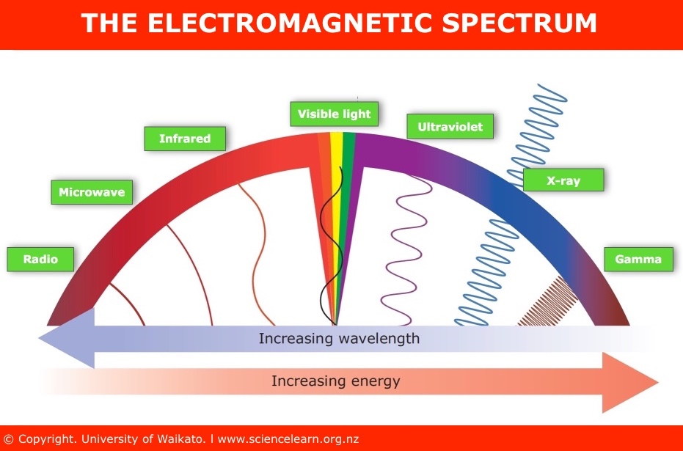

Slide 5



Slide 6

Spectrum = Eigenvalues
eigenvector
eigenvalue

Slide 7
Spectral Learning
Methods that use spectral information (e.g. eigenvectors, SVD) from matrices, which are usually derived from data, to solve any problem in ML
Can be unsupervised or supervised
VERY diverse methods fall under the umbrella of spectral learning
Many applications in NLP:
Word embeddings
Hidden Markov Models (HMMs)
Probabilistic context-free grammars (PCFGs)
Topic modeling
Dependency parsing
Word clustering
Weighted automata
Finite state transducers

Slide 8

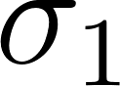
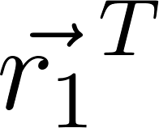
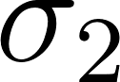
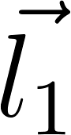


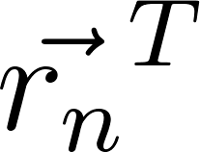


Singular Value Decomposition
0
.
.
.
.
.
. . .
.
0
Left singular vectors:
orthonormal eigenvectors of
Singular values:
Square root of non-zero eigenvalues of
Right singular vectors:
Orthonormal eigenvectors of

Slide 9

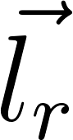
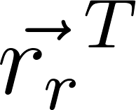

SVD Application: Best Rank-r Approximation
0
.
.
.
.
.
. . .
.
0
Left singular vectors
Largest singular values
Right singular vectors

Slide 10
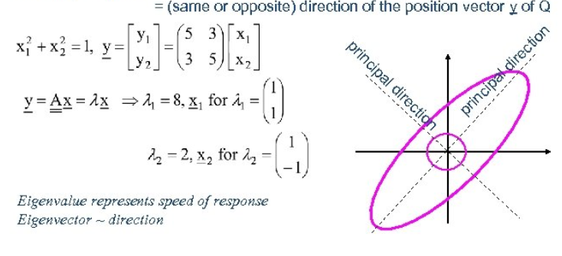
Singular Value Decomposition
For symmetric matrix: SVD same as eigenvalue decomposition
Source: Shana Clark, https://slideplayer.com/slide/10880770/

Slide 11
SVD Application: Principal Component Analysis
0
.
.
.
.
.
. . .
.
0
Principal components
(after centering):
. . .

Slide 12
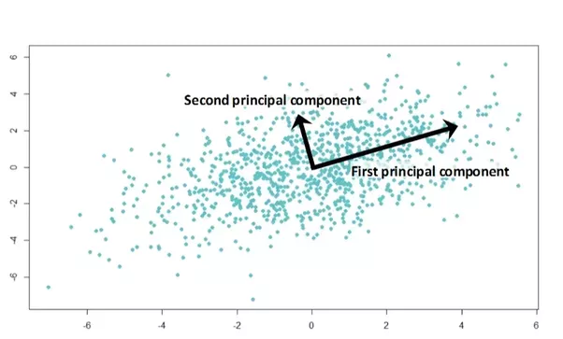
SVD Application: PCA

Slide 13
SVD
Complexity for m by n matrix: O(min(mn²,m²n))
Rank-k SVD: O(k² * min(m,n))
Efficient algorithms exist for online SVD: given SVD, compute SVD of matrix with new columns added
?

Slide 14
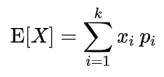
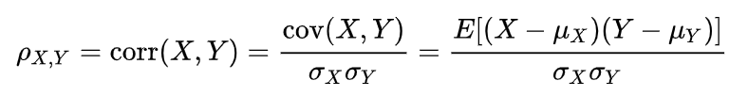
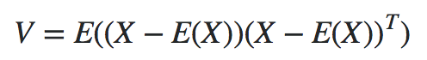
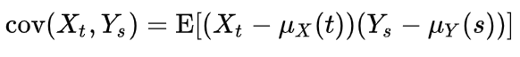
Statistics Review
Expectation:
Correlation:
Note: invariant to scaling and translation
Variance:
Covariance:
Cross-covariance matrix between two processes:

Slide 15
Method of Moments
k^{th} moment of X: E[X^{k}] (but modified “moments” are used in spectral algorithms)
Method of estimating model parameters:
Express moments in terms of model parameters
Compute empirical moments using data
Solve system of equations in terms of measurements to estimate model parameters
In spectral learning literature, this is the “spectral” part: tensor decompositions, SVDs used

Slide 16
Method of Moments
f(true variable) = g(model parameters)
Empirical measurements of variables
Calculate f(measurements)
Invert g to solve for model parameters

Slide 17
Canonical Correlation Analysis (1935)
Goal: Given paired samples of multivariate random variables X=(X₁...X_{m1}) in R^{m1} and Y=(Y₁...Y_{m2}) in R^{m2}, want to analyze correlation between them
In practice, given n samples from X’s distribution and n samples from Y’s distribution
Require: d vectors (a_{i},b_{i}) (d ≤ m₁,d ≤ m₂) with which to transform the original variables. (a,b) are defined recursively to maximize correlation with each other, but zero correlation to previously computed vectors

Slide 18
Canonical Correlation Analysis (1935)
X
Y
height
Iron consumption
weight
Soy consumption
BMI
Potassium consumption
How related are these two multivariate distributions?
Blood pressure

Slide 19
Canonical Correlation Analysis (1935)
X
Y
height
Iron consumption
Project
Project
Soy consumption
weight
BMI
Potassium consumption
Blood pressure
Find sequence of linear combinations:
0.2*height + 0.5*weight + 3*BMI + 0.1*blood pressure is maximally correlated with
0.7*iron + 2*soy + 1.5*potassium
etc.

Slide 20
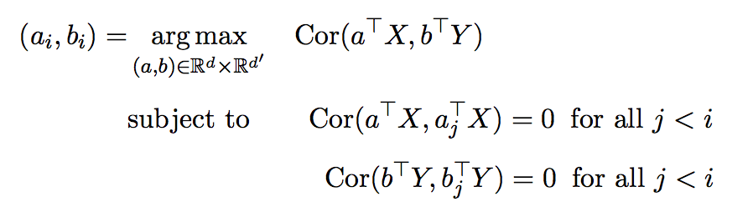
Canonical Correlation Analysis (1935)
Source: Stratos, PhD Thesis 2016

Slide 21
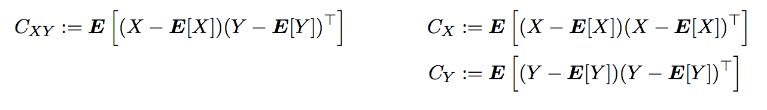
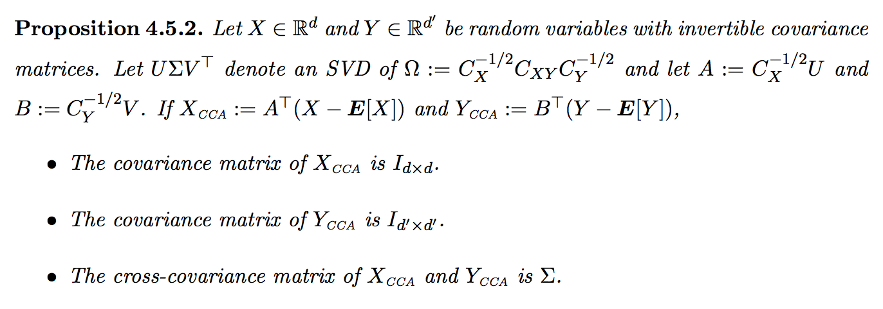
Canonical Correlation Analysis (1935)
Alternative formulation: Define the cross-covariance and covariance matrices:
Interpret as a whitening procedure
Cross-covariance matrix is diagonal
Source: Stratos, PhD Thesis 2016

Slide 22
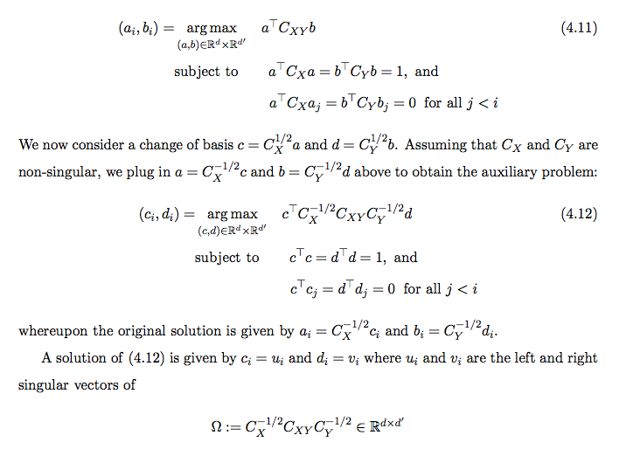
Solving CCA
Source: Stratos, PhD Thesis 2016

Slide 23
Solving CCA
SVD of an m by n matrix
O( min(mn²,m²n) )
But faster methods for large matrices!
Source: Stratos, PhD Thesis 2016

Slide 24
CCA with Shared Latent Variable
Theorem by Foster et al, 2008 (summarized):
If X and Y are conditionally independent given H (dimension m), then the best linear predictor of H given the top m correlated/transformed dimensions of X is as good as the best linear predictor of H given all of X
Basically: Under shared latent variable assumption, CCA for dimensionality reduction preserves linear predictive power

Slide 25
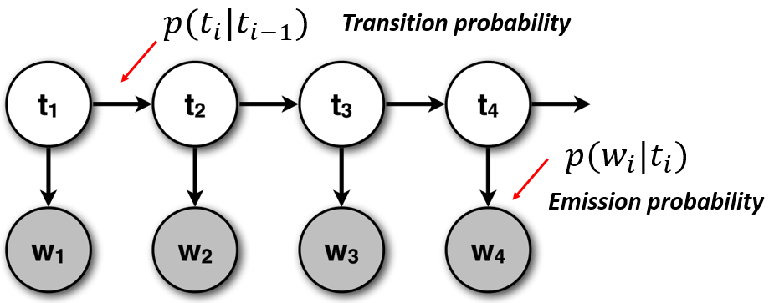
Hidden Markov Models

Slide 26
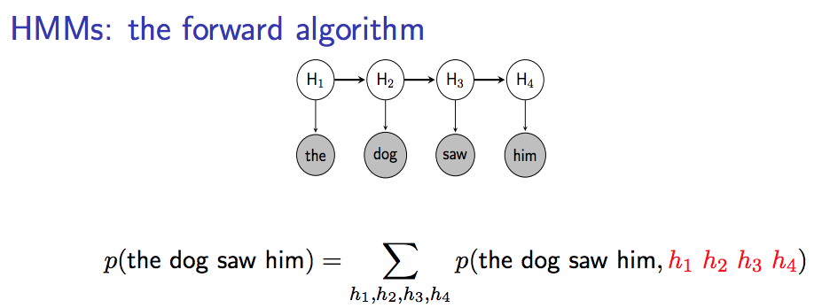
Spectral Learning of Hidden Markov Models
Slides from: NAACLO 2013 Tutorial

Slide 27
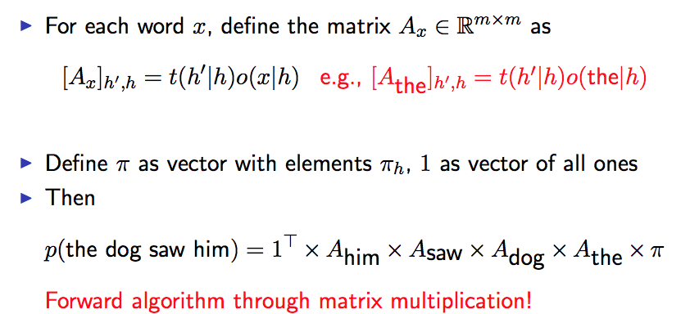
Spectral Learning of Hidden Markov Models
Slides from: NAACLO 2013 Tutorial

Slide 28
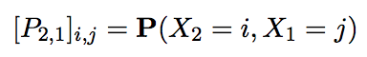
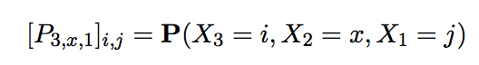
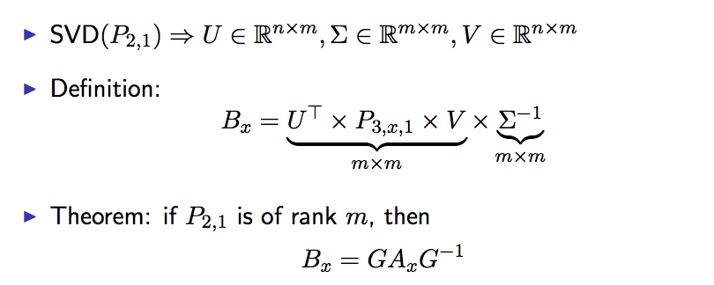
Spectral Learning of Hidden Markov Models
Slides from: NAACLO 2013 Tutorial

Slide 29
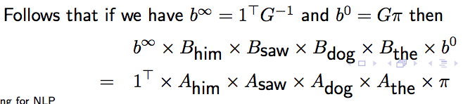
Spectral Learning of Hidden Markov Models
Can use the B matrices to calculate probability of any sequence, thanks to cancelation:
Slides from: NAACLO 2013 Tutorial

Slide 30
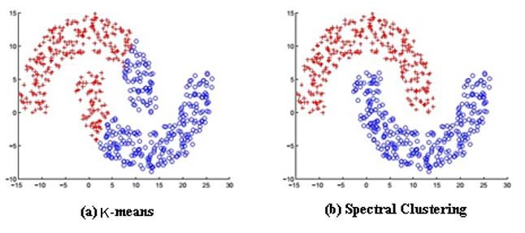
Spectral Clustering
Very different flavor from other spectral methods: relation to graph theory
Uses eigenvectors to reduce dimension before clustering
Fig: Adbelkarim Ben Ayed

Slide 31
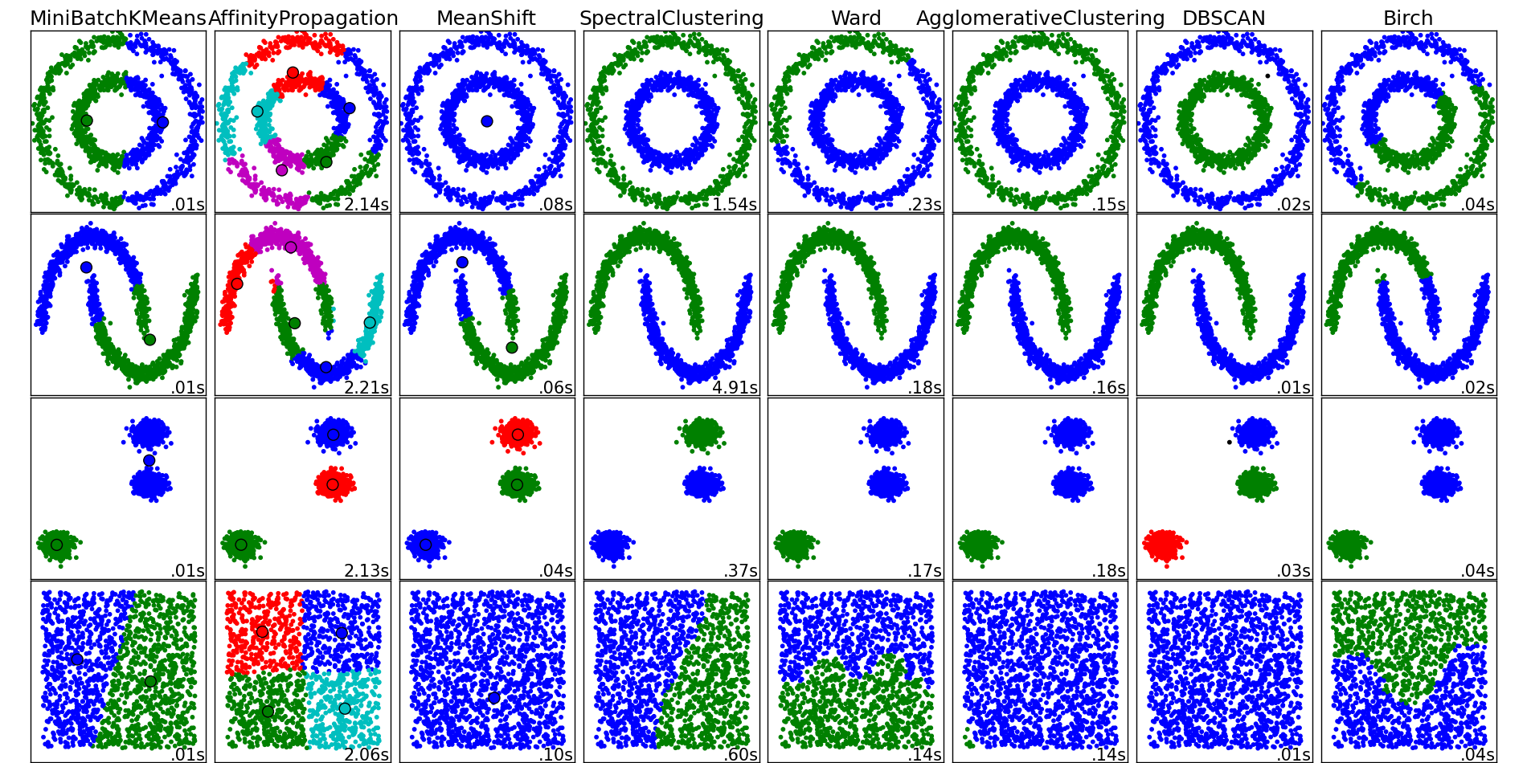
Spectral Clustering
Fig: Hoang Duong

Slide 32
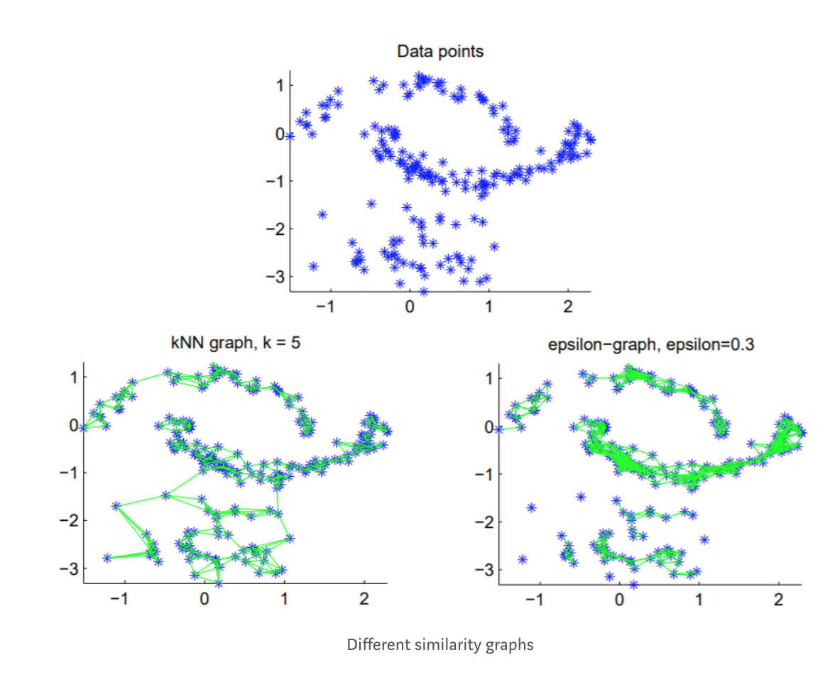
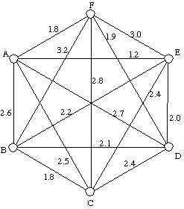
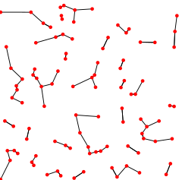
Spectral Clustering
1. Create a graph from the data points using a specified scheme. Assume we have access to a similarity measure between pairs of points.
ε-neighborhood
k-nearest neighbor
Fully connected

Slide 33
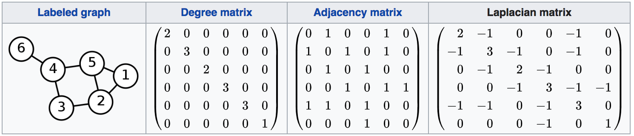
Spectral Clustering
2.Compute Laplacian matrix of the graph (or some variant):
L = D - A
Fig: Wikipedia

Slide 34
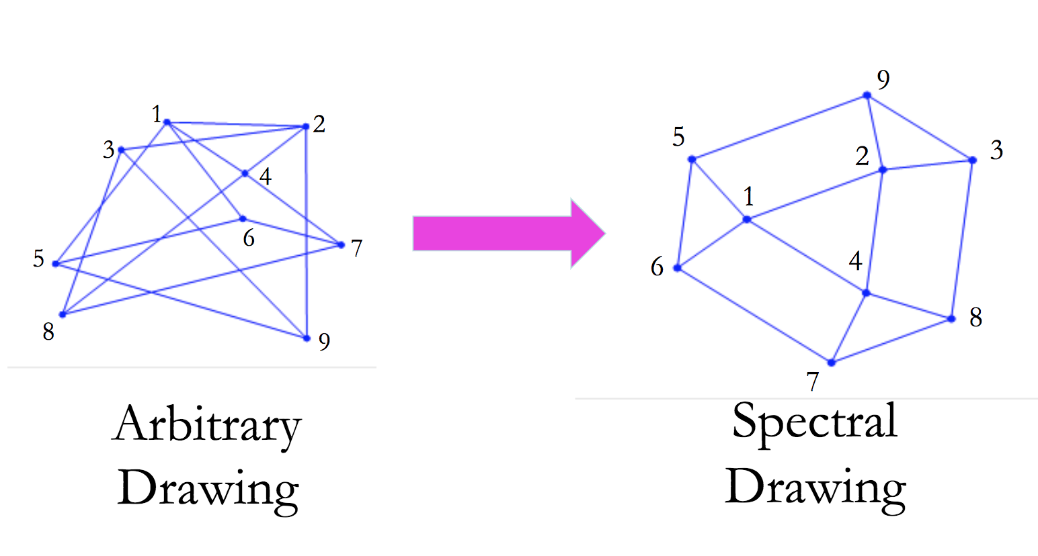
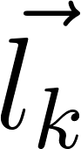
Spectral Clustering
3.Use first few eigenvectors for dimensionality reduction
1st datapt
. . .
n^{th} datapt
Theoretical results on “spectral drawings” like these:
E.g. in 2D get nice drawings (vertices spread out, don’t get too close).
First k eigenvectors of L, ordered by eigenvalue
(skip 0, which has constant eigenvector)
Fig: D. Spielman

Slide 35

Spectral Clustering
4.Cluster using existing techniques in lower-dimensional space, often k-means
Pick initial # clusters and center for each cluster
Each point goes in the closest cluster
Recompute each center as average of constituent points
Iterate
Fig: Wikipedia

Slide 36
Example: Spectral Clustering in NLP
Computing Word Classes Using Spectral Clustering (2018):
Apply spectral clustering to lexicon of words
Similarity based on word co-occurrence counts
Use matrix variants: D⁻¹A and D^{-1/2}AD^{-1/2}
Use as features for two NLP tasks:
Semantic role labeling
Dependency parsing

Slide 37
Eigenwords: Spectral Word Embeddings
Dhillon (MIT), Foster (UPenn), Ungar (UPenn) JMLR 2015
Spectral Learning for Word Embeddings
Paper #1

Slide 38
Paper Summary
Use canonical correlation analysis to derive word embeddings
Propose 4 algorithms for learning word embeddings, all fast/scalable
Test on: word similarity, sentiment classification, named entity recognition, chunking, analogies, and word sense disambiguation
Best performance out of all 4 is comparable to best word embeddings (usually word2vec) on most tasks, but no single method of the four is consistently superior

Slide 39
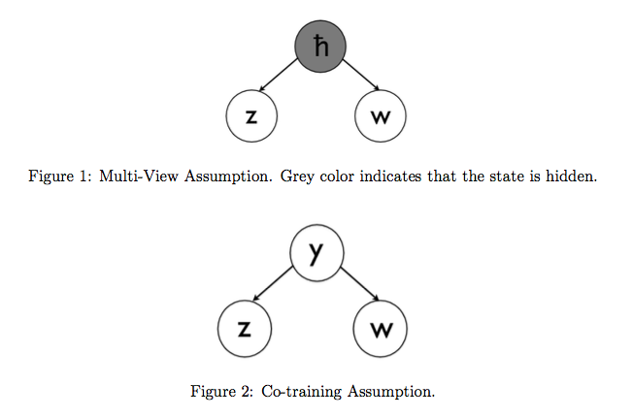
Multiview Assumption
Satisfied: assume generative model is HMM. Just like “shared latent variable” view of Foster

Slide 40
Algorithm #1: One Step CCA (OSCCA)
Run canonical correlation analysis once between the words and their contexts
V = size of vocabulary
Multivariate random variable X in R^{V} = one-hot vector for word
Multivariate random variable Y in R^{2hV} = indicator vector for word context, window of length h

Slide 41
Algorithm #1: One Step CCA (OSCCA)
X in R⁵
Y in R¹⁰
“He plays with the dog”
Suppose:
V (vocab size) = 5
H (context size) = 1
0
0
he
1
0
plays
0
Left context
1
with
0
0
the
0
0
dog
0
0
0
Right context
1
0

Slide 42
Algorithm #1: One Step CCA (OSCCA)
X in R⁵
Y in R¹⁰
“He plays with the dog”
Suppose:
V (vocab size) = 5
H (context size) = 1
0
0
he
0
0
plays
1
Left context
0
with
0
1
the
0
0
dog
0
0
0
Right context
0
1

Slide 43
Algorithm #1: One Step CCA (TSCCA)
Left and right context
(concatenated)
One-hot word vector
CCA
Word embeddings

Slide 44
Algorithm #1: One Step CCA (OSCCA)
Each token in training data corresponds to a new paired sample (x,y) from the distributions of random variables X and Y
To get word embeddings: run canonical correlation analysis on the two variables
Output: projection matrices P and Q such that:
Px and Qy are low-dimensional, for all word-context pairs (x,y)
Px and Qy have maximal covariance with one another
Px and Qy can be substituted for x and y in linear regression problems and still do well

Slide 45
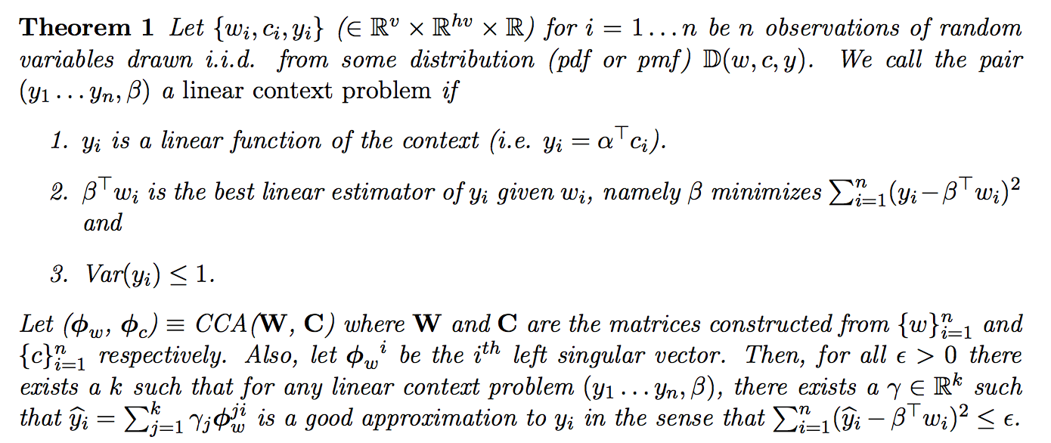
Algorithm #1: One Step CCA (OSCCA)
Learn coefficients from a few training examples

Slide 46
Algorithm #2: Two Step CCA (TSCCA)
Problem: some words are rare, and will only appear a few times in training data
Solution: TSCCA, which has better sample complexity for rare words
Idea: Break original scheme into two parts
Use CCA between left and right contexts (separately)
Use CCA between a low-dim. embedding from step 1 and one-hot word vectors to get word embeddings

Slide 47
Algorithm #2: Two Step CCA (TSCCA)
Left context
Right context
CCA
One-hot word vector
CCA
Word embeddings

Slide 48
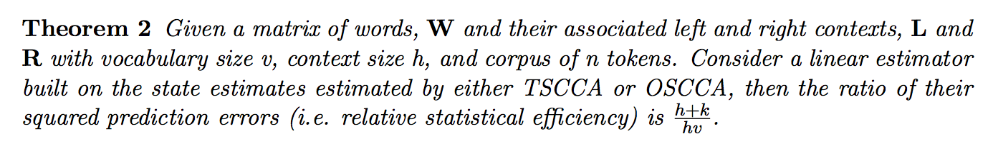
Algorithm #2: Two Step CCA (TSCCA)
Usually hv >> h+k
Benefit of this approach over OSCCA:
1.Theory:
2.Intuition:
For a rare word, finding a context embedding allows the 2nd CCA to “borrow information” from similar, frequent words (i.e. with similar context embeddings) to achieve a more accurate prediction

Slide 49
Alg. #3: Low Rank Multi-View Learning (LR-MVL)
Problem with previous algorithm: in the first CCA step, the left and right context vectors are very high-dimensional
In LR-MVL, work only in low-dimensional space by iteratively projecting the original context vectors before the first CCA, beginning with random
Result: considerable speed-up

Slide 50
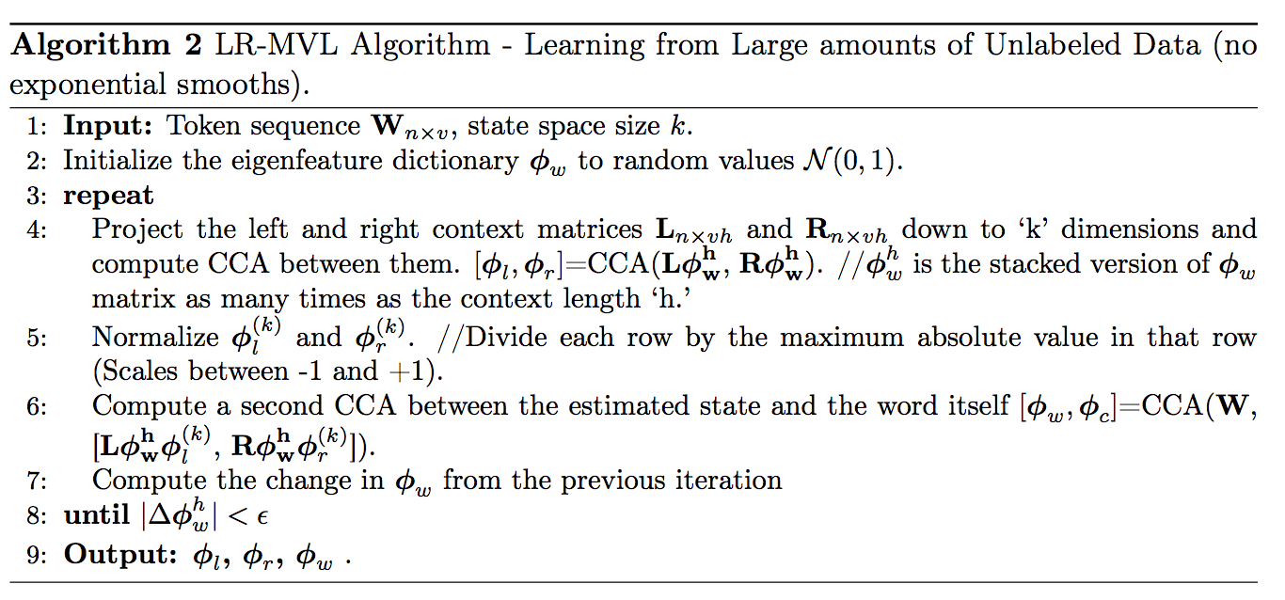
Alg. #3: Low Rank Multi-View Learning (LR-MVL)

Slide 51
Alg. #3: Low Rank Multi-View Learning (LR-MVL)
Repeat til conv.
Left context
Right context
Use current word embeddings to reduce dim. (matrix mult.)
CCA
One-hot word vector
CCA
Word embeddings

Slide 52
Alg. #4: Low Rank Multi-View Learning (LR-MVL)
With Exponential Smoothing
Slight modification to previous algorithm: instead of projecting directly via current word embeddings, use exponential smoothing to obtain low-dimensional context embedding

Slide 53
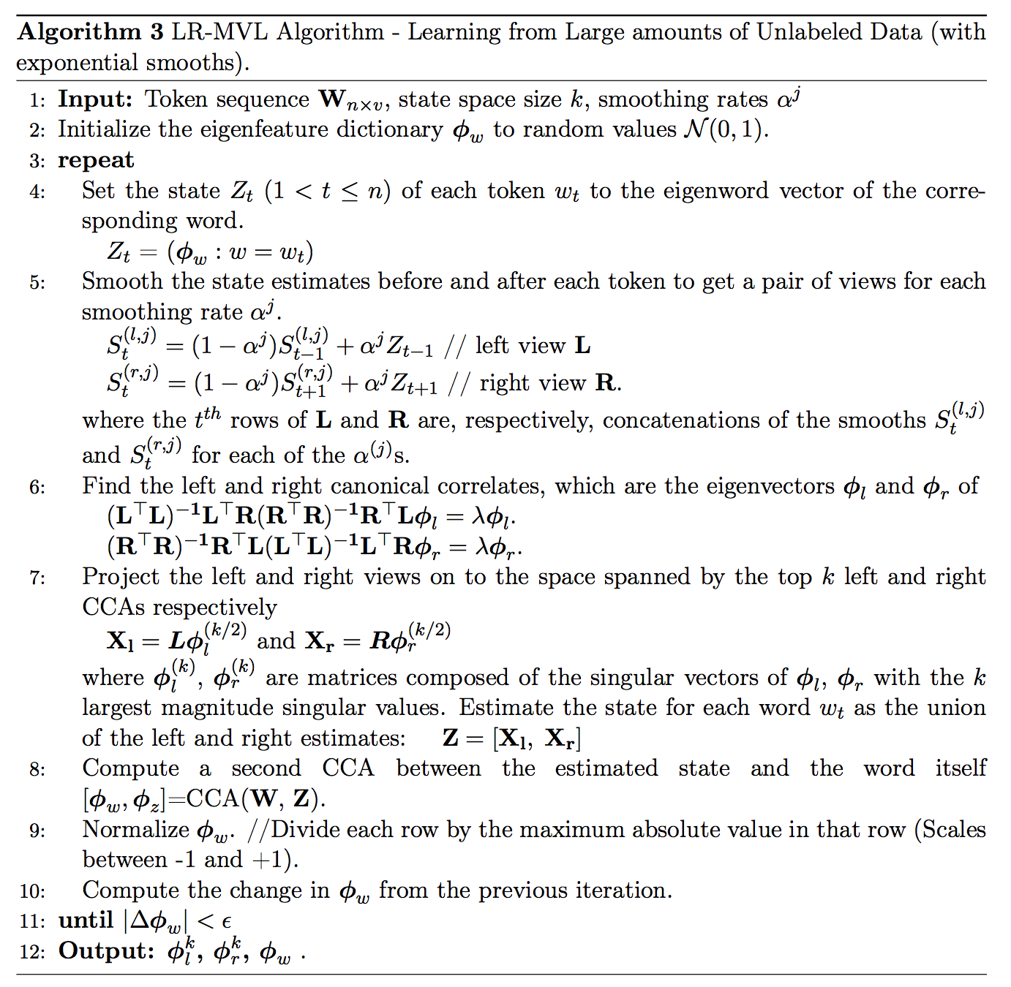

Slide 54
Alg. #4: Low Rank Multi-View Learning (LR-MVL)
With Exponential Smoothing
Repeat til conv.
Left context
Right context
Use current word embeddings to reduce dim. (exp. smoothing)
CCA
One-hot word vector
CCA
Word embeddings

Slide 55
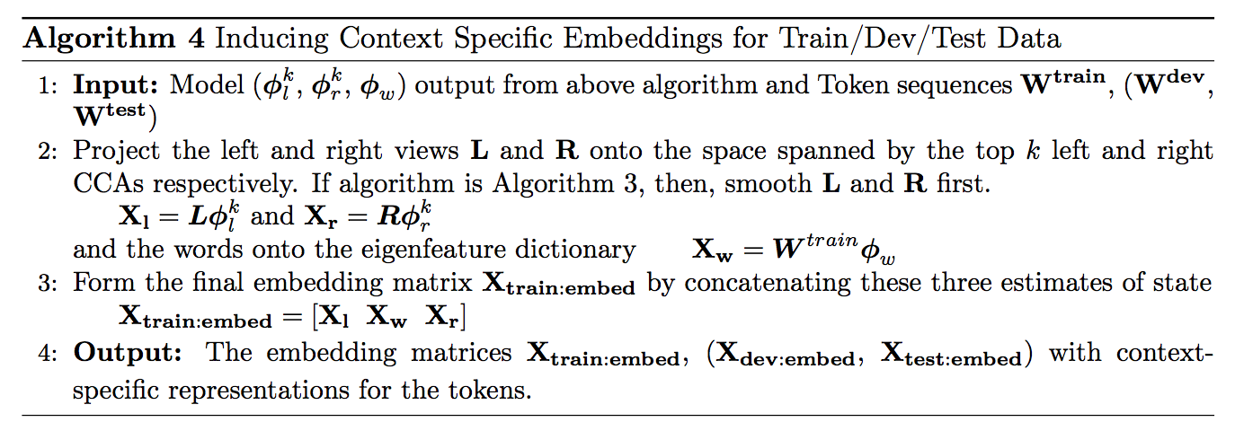
Context-Specific Embeddings
Can also use context-ignorant embeddings (i.e. simply one per type) directly with the output from previous algorithms

Slide 56
Results
Compare against: Turian [C&W, HLBL] (2010), SENNA (2011), word2vec (2013), as well as PCA as baseline
Train on Reuters RCV1 corpus
Qualitative assessment (nearest neighbors)
Tasks: POS tagging, word similarity, sentiment classification, named entity recognition, chunking

Slide 57
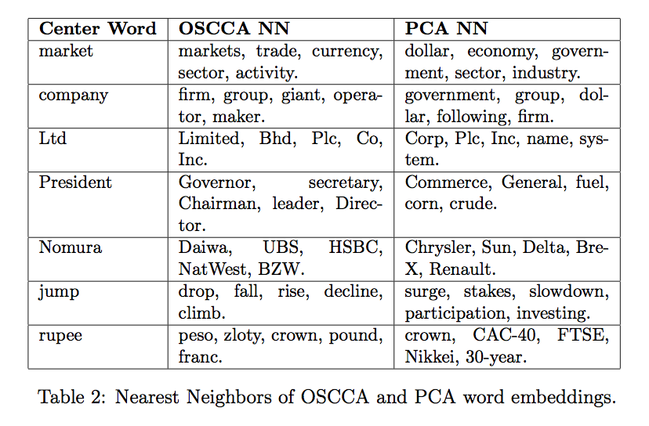
Nearest Neighbor Results (OSCCA and PCA)

Slide 58
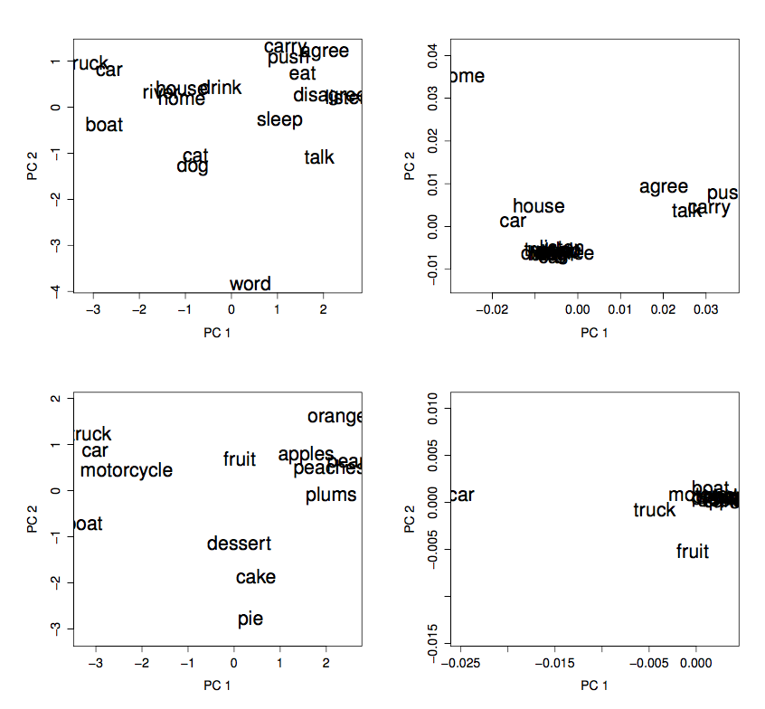
Nearest Neighbor Results (OSCCA and PCA)
OSCCA
PCA

Slide 59
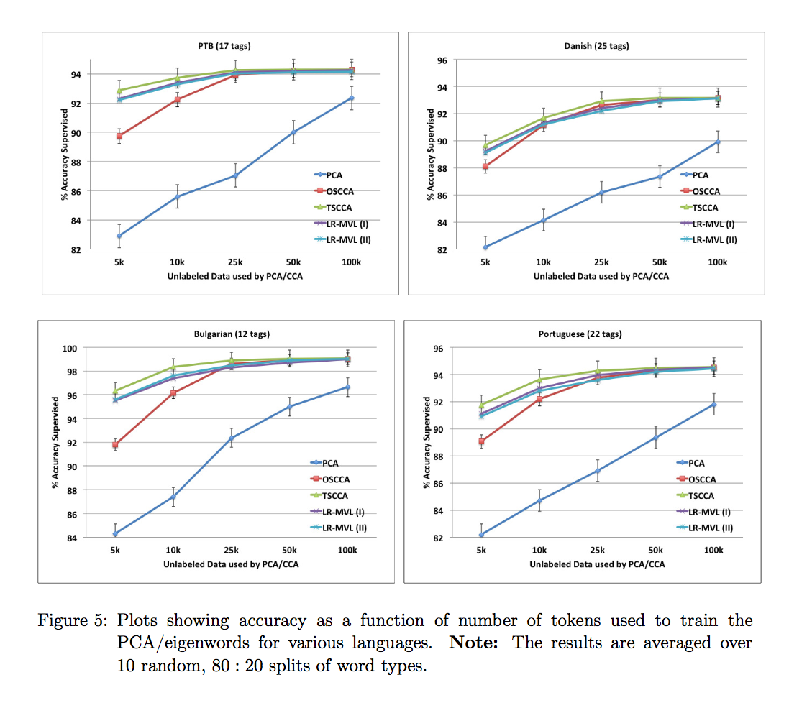
Part of Speech Tagging
Only compare to PCA

Slide 60
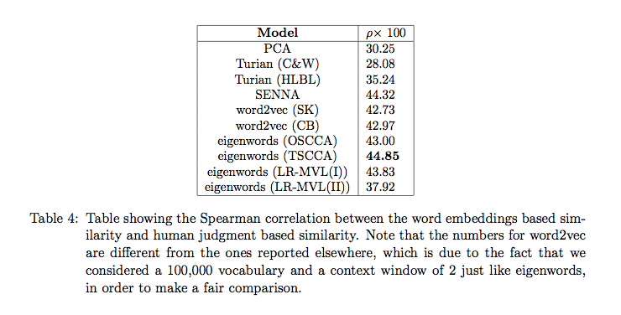
Word Similarity

Slide 61
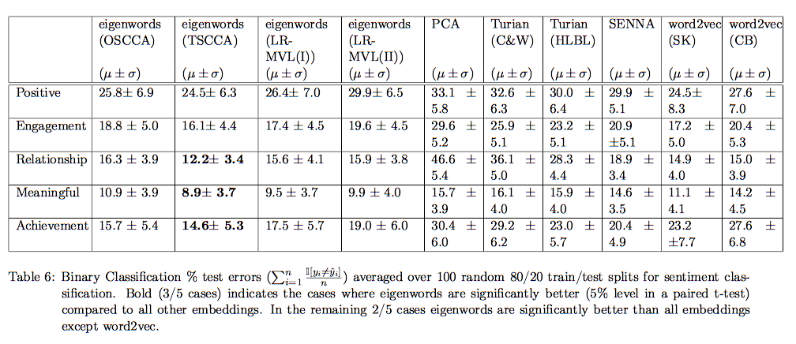
Sentiment Classification

Slide 62
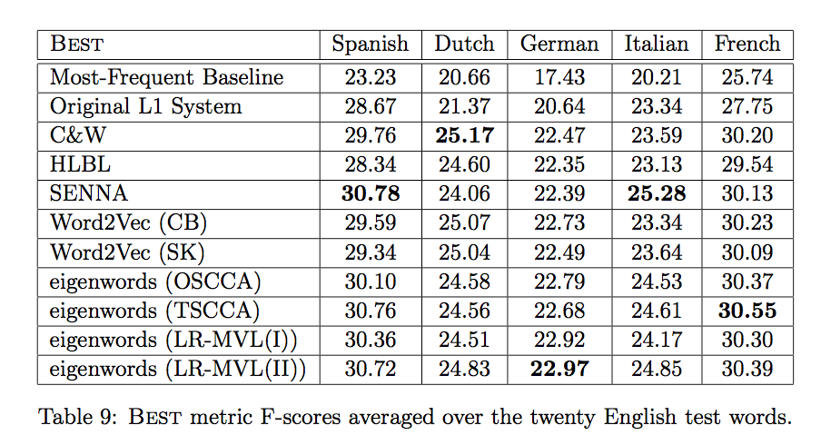
Word Sense Disambiguation

Slide 63
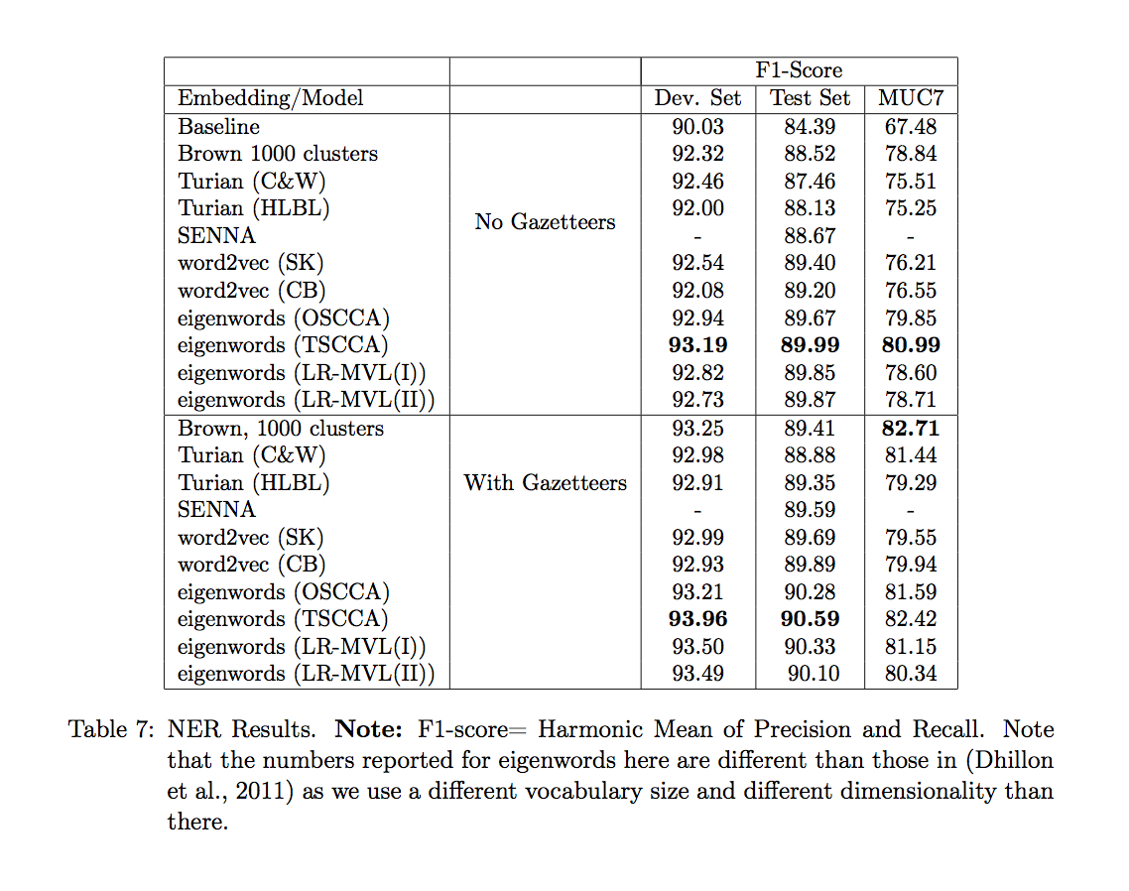
Named Entity Recognition

Slide 64
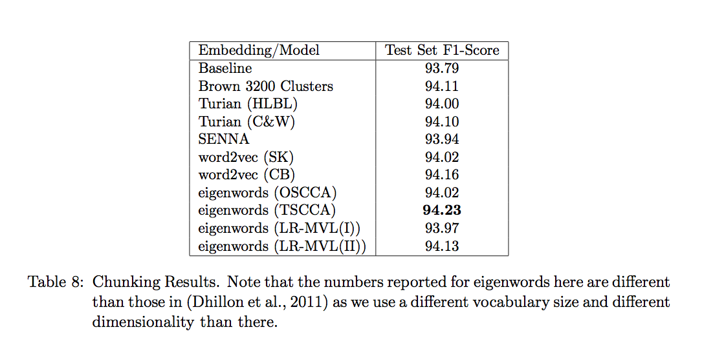
Chunking

Slide 65
Benefits of CCA-Based Algorithms
Scale-invariant
Capture multi-view information: left/right contexts vs bag of words
Fast
Rare words: better sample complexity
Option for context-specific embeddings
Underlying theory provides correctness guarantees
In this paper: distinction between left and right context of a word

Slide 66
Criticisms
Words follow Zipfan, not normal, distribution: have to use square root of counts
Presents a problem: which eigenword embedding to use? (They behave differently)
Theoretical guarantees, but not too much intuition behind many steps
Don’t test “lower sample complexity for rare words” compared to competitors

Slide 67
Discussion Questions
What are other “views” of words that could be useful for running CCA to generate embeddings?
Reminder: in this paper, they use the left and right contexts of the words
Eigenwords perform respectably on various tasks, but their primary distinguishing features are that they’re (1) fast to compute and (2) provably correct. Can you think of any contexts in NLP where these are particularly important characteristics?

Slide 68
Continuous Word Embedding
Fusion via Spectral Decomposition
Fu (GIT), Zhang (MSR), Mandt CoNLL 2018
Spectral Learning for Word Embedding Fusion
Paper #2

Slide 69

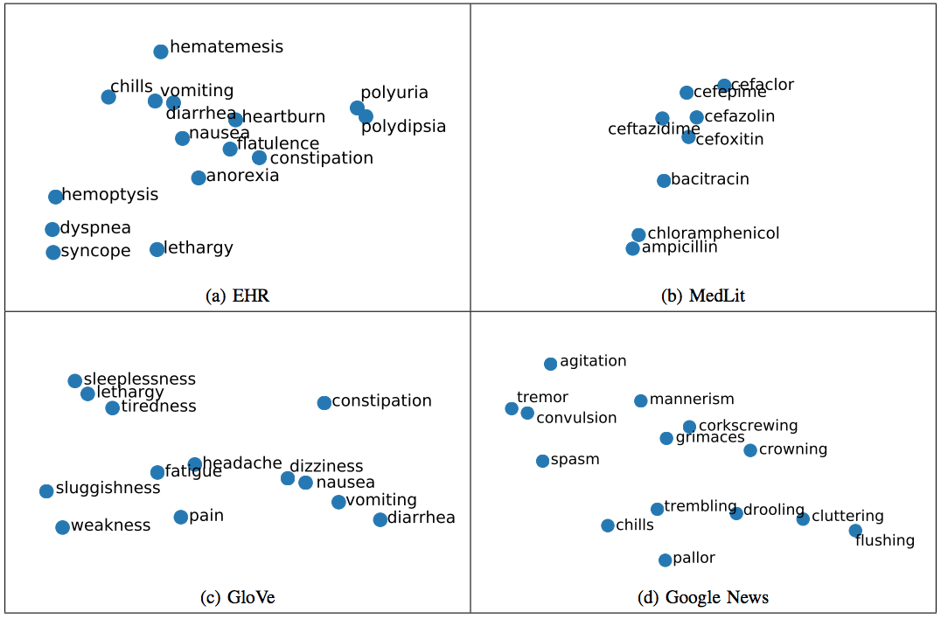
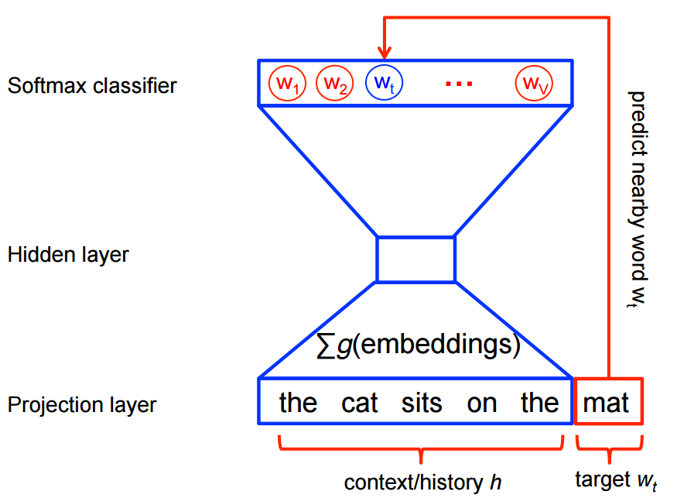
Problem
Exist: Pre-trained word embeddings on large corpus, e.g. news
Would like: word embeddings for specialized vocabulary, e.g. medical, scientific

Slide 70
Problem
Have a small, specialized corpus containing both common and specialized words
Would like word embeddings for the specialized words, as well as for regular words
Do not have resources to re-generate word embeddings for entire vocabulary
Instead, want to use existing word embeddings (e.g. word2vec)
Goal: create word embeddings for new words based on new corpus, and update existing embeddings to create a coherent set of embeddings

Slide 71
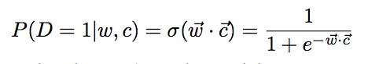
Word Embeddings as Matrix Factorization
Skip-gram with negative sampling (Mikolov 2013; word2vec): assumes a distribution on word-context pairs, and tries to learn low-dimensional word and context representations to maximize probability of occurrence of real pairs (and minimize probability of occurrence of bad pairs, hence “negative sampling”)
Distribution:
Objective:

Slide 72
Word Embeddings as Matrix Factorization
Skip-gram with negative sampling (Mikolov 2013; word2vec): assumes a distribution on word-context pairs, and tries to learn low-dimensional word and context representations to maximize probability of occurrence of real pairs (and minimize probability of occurrence of bad pairs, hence “negative sampling”)
Minimize probability of “negative” pairs: assume word + random context = negative example
Maximize probability of real word-context pairs

Slide 73




Word Embeddings as Matrix Factorization
Combine word embeddings into matrix W, context into C (Levy, Goldberg 2013). Set:

Slide 74

Word Embeddings as Matrix Factorization
D=set of all observed (word, context pairs)
Pointwise mutual information of (w,c)

Slide 75

Word Embeddings as Matrix Factorization
Modification to this matrix proposed by Levy and Goldberg:
Shifted positive pointwise mutual information (SPPMI) matrix
This is the matrix assumed by Fu et al. for the word embedding fusion task

Slide 76

Goal: Factor Larger Matrix
Assume: have access to this, or something very close to it, from existing word embeddings
Goal: find SPPMI matrix for extended vocabulary
Old, common words
New, specialized words

Slide 77
Acquiring Full Matrix
1. Assume: have access to this, or something very close to it, from existing word embeddings
2. Approximate x’ using word frequencies in new corpus, interpolating with exponential model for words that are not present
Old, common words
New, specialized words
4. Compute z’ directly from new corpus
3. Similar for estimating y’

Slide 78
Factoring Full Matrix (Efficiently)
1. Given access to original factorization in terms of W and C, compute SVD of mxm block
2. Use online SVD to obtain SVD of complete matrix, adding in block x’ and then block [y’ z’]
Old, common words
3. Easily factor into word and context embeddings using full SVD
New, specialized words

Slide 79

Factorization → SVD

Slide 80

Online SVD
Given SVD of small matrix, compute SVD when you add new columns
Complexity O(nd²)
?

Slide 81

Complete Algorithm
Entire problem: computing the SVD of a matrix!
(Well, also computing the matrix first.)

Slide 82

Theoretical Guarantees
Assumptions:
SPPMI matrix is sparse: linear number of nonzero entries (c₁m)
Word and context co-appear < c₂ times
Min. diagonal entry in SPPMI matrix is at least c₃sqrt(m)

Slide 83
Empirical Tests
Test on pre-trained word embeddings based on English Wikipedia (http://u.cs.biu.ac.il/~yogo/data/ syntemb/bow5.words.bz2)
Small, domain-specific corpora: NIPS abstracts 2014-2016 (981 new words) and articles from “Economy News” (868 new words)
Timing: 1 minute to generate word embeddings for 1,000 words into pre-trained set of 180,000 embeddings

Slide 84
Baselines
Fix Old, Update New (FOUN): fix the old word/context vectors, and only update new words. Use SGD to minimize word2vec objective
FOUN + annealing: As above, but add Gaussian noise to gradient

Slide 85

Results: Semantics (Qualitative)

Slide 86

Results: Word Similarity

Slide 87

Results: Word Analogy

Slide 88

Results: Word Analogy

Slide 89
Paper Summary
A parameter-free algorithm for incorporating new words into an existing set of word embeddings
Consider word embeddings as the result of a matrix factorization of pointwise mutual information matrix
Finding embeddings for new words becomes an online SVD problem
Method is parameter-free and fast; performance on word similarity and analogy tasks is respectable, compared to baselines

Slide 90
Criticisms
Only works for word embeddings that came from models that have matrix factorization interpretation, e.g. skipgram
Assumes that corpus of new vocabulary is significantly smaller than original corpus: disadvantages having a large specialized corpus
Assumes access to W and C matrices, which may not be realistic for existing word embeddings
Some of approximation assumptions unrealistic in computing new SPPMI matrix
Theoretical bound on approximation hides some big constants
Baselines weak: better to pick a different specialized corpus, and compare to SOTA embeddings on that corpus
Testing limited; other downstream NLP tasks to test word embeddings

Slide 91
Discussion Questions
What are some applications or specific problems where it might be useful to have context-specific word embeddings?
How about instances where we’d like to re-use an existing, larger body of word embeddings?

Slide 92
Spectral Learning for
Supervised Topic Models
Ren, Wang, Zhu (Tsinghua) IEEE 2017
Spectral Learning for Topic Modeling
Paper #3

Slide 93
Paper Summary
Two spectral learning algorithms for supervised Latent Dirichlet Allocation achieve theoretical guarantees and performance comparable to SOTA
Two-stage algorithm: first find parameters of LDA, then regression model
One-stage algorithm: jointly recover topic distribution and regression weights by tensor decomposition

Slide 94

Review: Topic Modeling by LDA
Per-topic word distribution
(Parameter for Dirichlet)
(Parameter for Dirichlet)
Per-doc topic distribution
Topic for particular word
The word

Slide 95

Supervised LDA
Additional variable measured: y
E.g. User-generated tags for an image
Per-topic word distribution
Per-doc topic distribution
Topic for particular word

Slide 96
Two-Stage Method
Goal: recover (1) the topic matrix O, which describes the distribution of words per topic, and (2) the regression model n, a vector of coefficients for each topic that predicts the response variable y
Strategy: Use the method of moments. Use iid sampled documents to estimate “moments” (which are low-rank tensors, and functions of the desired LDA parameters), and by whitening and tensor decomposition procedures, recover the topic and per-topic word distributions

Slide 97
Method of Moments
f(true variable) = g(model parameters)
Empirical measurements of variables
Calculate f(measurements)
Invert g to solve for model parameters
Idea: Pick a good f such that you can solve for the model parameters (i.e. g is in some way invertible)

Slide 98



Equivalent Definitions of “Moments”
Per-topic word distribution
For estimation via training data:
There are k topics
For analysis:

Slide 99

Two-Stage Method
Compute f
“Invert” g

Slide 100
Two-Stage Method
Disadvantage: recovery of the per-topic word distributions does not use any supervision, i.e. the supervision signal y that is also provided.
This is a result of separating the topic distribution recovery and regression model recovery into two distinct steps.
As a result, in practice the recovered topics are not good enough for prediction tasks
Solution: infer both in one step

Slide 101



One-Stage Method
Again use method of moments, but on elongated vectors z = [x, y], where x is the word vector and y the response variable

Slide 102

One-Stage Method

Slide 103

Theoretical Guarantee
With enough samples...
...recovered values are “close”

Slide 104

Results: Synthetic Dataset

Slide 105

Results: Hotel Reviews

Slide 106

Results: Movie Reviews

Slide 107
Criticisms
Theoretical results are very messy
Have to make some possibly unrealistic assumptions, eg. topic distribution vectors are linearly independent
Robust tensor decomposition fails when topic number is greater than 9
Intuition behind what robust tensor decomposition is doing, and why it works?
Notion of supervised data is restricted; must be linear combination of topics

Slide 108
Discussion Questions
What are some corpuses/applications where supervised topic modeling applies?
What are some examples of supervised information, which might be a linear function of constituent topics?
What other sorts of supervised information might appear in NLP (i.e. anything, not necessarily a linear combination of the topics)? How would it fit into the standard LDA model?

Slide 109
Diversity in Spectral Learning for
Natural Language Parsing
Narayan, Cohen (Edinburgh) EMNLP 2015
Spectral Learning for Dependency Parsing
Paper #4

Slide 110

PCFGs for Parsing
Defined by:
(1) nonterminal symbols (2) terminal symbols (3) production rules (4) start symbol (5) probabilities for each production rule

Slide 111

Latent PCFGs for Parsing
In addition: each non-terminal associated with a latent state, which provides context information
2013: Cohen et al. present spectral algorithm for learning L-PCFGs, show that it outperforms expectation-maximization

Slide 112
Paper Summary
Use spectral clustering to indirectly learn L-PCFGs, and add noise to obtain diverse parses for improved accuracy
Initial, intuitive spectral clustering algorithm for learning L-PCFGs
After observing the diversity of its estimates, the authors decided to seed the algorithm with different types of random noise
They combine the diverse results from each noise scheme to obtain a final parse, improving accuracy over the clustering algorithm alone

Slide 113

Inside and Outside Trees

Slide 114
Inside and Outside Trees
By L-PCFG model: inside and outside trees of a non-terminal a are conditionally independent, i.e. when latent state is known.
So, latent state should be identifiable precisely by patterns that co-occur in inside and outside trees.

Slide 115
Inside and Outside Trees
For fixed a:
Create low-dimensional embeddings for inside and outside trees
Estimate cross-covariance over all inside/outside embeddings
Reduce dimensions via SVD
Assign hidden states by clustering in this low-dimensional space
Frequency count MLE to estimate probability of parameters in L-PCFG

Slide 116


Tree Embeddings
Assume as given: two feature functions and , send inside (and outside) trees to vectors
Features same as those used in previous literature (Cohen et al, 2013)
For example:
Inside trees: the rule, the words themselves, the entire tree’s head part of speech
Outside trees: label of foot node, its parent and grandparent, nearby rules, more complex features

Slide 117

Cross-Covariance Matrix
Given M training examples and a, a particular nonterminal symbol in the grammar, define the matrix:
Inside tree embedding
Outside tree embedding
Indicators: only sum examples involving a

Slide 118

Cross-Covariance Matrix
Recall assumption: inside and outside trees split at a are independent, conditioned on latent state at a
So, different latent states of a should be identifiable by patterns that co-occur in inside and outside trees
These distinct patterns should be captured by a singular value decomposition of , which was a summation over outer products between inside and outside tree embeddings

Slide 119

Cross-Covariance Matrix
Rank-1 matrices
Recall one view of SVD:
Summation over many different latent states that appear in training examples

Slide 120

Dimensionality Reduction
Low-dimensional; akin to change of basis

Slide 121

Clustering
Note: they use k-means algorithm for clustering

Slide 122

Final Parameters

Slide 123

Overall Algorithm
Split all training examples into inside and outside trees
For each non-terminal, compute sample covariance matrix
SVD on sample-covariance matrices
Use SVD to reduce dimension and cluster
Define latent states based on clusters
Label every node in training data with latent state, and compute probabilities

Slide 124
Noise Schemes
This clustering algorithm performed worse than original algorithm proposed in 2013. Proposed reason: k-means clustering finds local max
However, empirically: clustering gives diverse set of solutions when tree features are perturbed
Precedent: having a diverse set of predictions can be helpful in NLP

Slide 125
Noise Schemes
Add various types of noise:
Dropout noise: set feature vectors to 0 with some probability (pre-SVD)
Inspired by neural network training: drop connections between units to avoid overfitting
Gaussian (additive): add normally distributed noise post-SVD
Gaussian (multiplicative): coordinate-wise multiplication with normally distributed noise post-SVD
Note: Gaussian noise must be post-SVD to preserve sparsity, and thus speed, in SVD step

Slide 126
Combining Multiple Models
Noise schemes don’t improve model on their own, but do when combined
Various options for how to combine multiple models:
Maximal tree coverage: For each model, find the most probable output tree. The final parse tree is the tree has the greatest overlap in grammar rules with all of these trees
Maximal marginal coverage: The final parse tree is the tree that maximizes the marginal probabilities predicted for each rule by the various models
MaxEnt reranking: Select one of the parses from the models

Slide 127


Combining Multiple Models
Maximal tree coverage
Maximal marginal coverage
Note: can even combine these various methods, e.g. MaxEnt on several subsets of models, then combining the outputs via maximal tree coverage

Slide 128
Testing
Test on German and English
Compare to spectral algorithm of Cohen et al (2012): also apply dropout and Gaussian noise schemes, with model combination
English: Penn WSJ treebank
German: NEGRA
Error is F1 score from PARSEVAL metric: 2(precision*recall)/(precision+recall), where precision and recall are with respect to constituents of the parse trees

Slide 129

Results: English

Slide 130


Results: English

Slide 131


Results: English

Slide 132

Results: German

Slide 133


Results: German
“Comparable to SOTA” (at time of release) on this dataset (84.5 in 2010)

Slide 134
Criticisms
Adding noise: somewhat arbitrary, requires repeating procedure many times (10-100) - softens any advantage in efficiency and parameters
Only compare to other spectral algorithms from particular paper, not EM or SOTA parsing
Do not provide theoretical guarantees (due to k-means clustering); breaks one of the main advantages of spectral learning
Not an overwhelmingly strong case for advantage over existing spectral algorithm: e.g., say fewer parameters but do not include information about runtime

Slide 135
Paper Summary
Presented simple clustering algorithm: fewer parameters than existing spectral algorithms (97K vs 54 million for same number of latent states)
Diverse set of parses, and methods for combining them: improve both their algorithm and existing spectral algorithm

Slide 136
Discussion Questions
What are other tasks in NLP where you might be able to achieve a marginal performance increase by perturbing the data a few times, and recombining results?
Is the model assumption - that inside and outside trees are independent, conditioned on a learnable latent state - reasonable?
What are other ways that this model might be improved?

Slide 137
Summary of Spectral Learning
Wide variety of approaches: canonical correlation analysis, method of moments, spectral clustering, matrix factorization
General advantages: speed, theoretical guarantees (although make assumptions on data). Performance on tasks is usually good, not always overwhelmingly better than existing methods/SOTA
Apply to huge variety of NLP tasks, including parsing, generating word embeddings, incorporating new words into a set of embeddings, and unsupervised and supervised topic modeling

Slide 138
New Directions for Spectral Learning
Spectral learning algorithms for weighted finite automata have been connected to recurrent neural networks; get provable spectral algorithm for learning 2-RNNs (Rabusseau et al 2013)
Spectral clustering quite popular, although less use in NLP. Recent approaches use it as framework for understanding clustering with deep learning (e.g. Deep Spectral Clustering Learning, Spectral Clustering Using Deep Neural Networks, etc.)
Graph convolutional networks might also be considered spectral learning: also use eigenvectors of Laplacian (or at least, early iterations of GCNs motivated by this idea)

Slide 139
Discussion Questions
Many proponents of spectral learning prefer it to other methods because it provides theoretical guarantees of global (rather than local) optimality and convergence. What sort of value do theoretical guarantees have in a highly empirically-driven field like NLP?
Do you think we’ll see a comparable surge of theoretically sound SOTA methods in the next few decades?
In addition, spectral learning is often outperformed by alternatives (EM for the same model, or neural architectures for the same task). What sort of value might spectral approaches have in the future?
Which of the various spectral methods presented (CCA, PCA, clustering, online SVD, method of moments, etc.) seem the most promising?

Slide 140
Discussion Questions
Can you think of any other areas of NLP where CCA might be applied?
(Recall: CCA finds the most correlated linear combinations of two multivariate “views” of a single entity)
How about spectral clustering?
Spectral methods are sometimes outperformed by other methods, but have the advantage of speed. What are some areas of NLP where efficiency is more important than getting the absolute best accuracy?
How might spectral approaches be used in conjunction with other (neural, EM) approaches?

Slide 141
The End
Thanks!

